Slide 1
Research Paper PPTs

Slide 2
What is a research paper?
A research paper is a type of academic writing that provides an in-depth analysis, evaluation, or interpretation of a single topic, based on empirical evidence.
Research papers are similar to analytical essays, except that research papers emphasize the use of statistical data and preexisting research, along with a strict code for citations.

Slide 3
How long should a research paper be?
The length of a research paper depends on the topic or assignment. Typically, research papers run around 4,000–6,000 words, but it’s common to see short papers around 2,000 words or long papers over 10,000 words.

Slide 4
How to write a research paper in 9 steps
(1) Understand the assignment
For some of you this goes without saying, but you might be surprised at how many students start a research paper without even reading the assignment guidelines.
So your first step should be to review the assignment and carefully read the writing prompt. Specifically, look for technical requirements such as length, formatting requirements (single- vs. double-spacing, indentations, etc.) and citation style. Also pay attention to the particulars, such as whether or not you need to write an abstract or include a cover page.
Once you understand the assignment, the next steps in how to write a research paper follow the usual writing process, more or less. There are some extra steps involved because research papers have extra rules, but the gist of the writing process is the same.

Slide 5
2. Choose your topic
In open-ended assignments, the student must choose their own topic. While it may seem simple enough, choosing a topic is actually the most important decision you’ll make in writing a research paper, since it determines everything that follows.
Your top priority in how to choose a research paper topic is whether it will provide enough content and substance for an entire research paper. You’ll want to choose a topic with enough data and complexity to enable a rich discussion. However, you also want to avoid general topics and instead stick with topics specific enough that you can cover all the relevant information without cutting too much.

Slide 6
3. Gather preliminary research
The sooner you start researching, the better—after all, it’s called a research paper for a reason.
To refine your topic and prepare your thesis statement, find out what research is available for your topic as soon as possible. Early research can help dispel any misconceptions you have about the topic and reveal the best paths and approaches to find more material.
Typically, you can find sources either online or in a library. If you’re searching online, make sure you use credible sources like science journals or academic papers. Some search engines—mentioned below in the Tools and resources section—allow you to browse only accredited sources and academic databases.

Slide 7
4. Write a thesis statement
Using what you found in your preliminary research, write a thesis statement that succinctly summarizes what your research paper will be about. This is usually the first sentence in your paper, making it your reader’s introduction to the topic.
A thesis statement is the best answer for how to start a research paper. Aside from preparing your reader, the thesis statement also makes it easier for other researchers to assess whether or not your paper is useful to them for their own research. Likewise, you should read the thesis statements of other research papers to decide how useful they are to you.

Slide 8
5. Determine supporting evidence
At this stage of how to write an academic research paper, it’s time to knuckle down and do the actual research. Here’s when you go through all the sources you collected earlier and find the specific information you’d like to use in your paper.
Normally, you find your supporting evidence by reading each source and taking notes.

Slide 9
6. Write a research paper outline
A lot of students want to know how to write a research paper outline. More than informal essays, research papers require a methodical and systematic structure to make sure all issues are addressed, and that makes outlines especially important.
First make a list of all the important categories and subtopics you need to cover—an outline for your outline! Consider all the information you gathered when compiling your supporting evidence and ask yourself what the best way to separate and categorize everything is.

Slide 10
7. Write the first draft
Once your outline is finished, it’s time to start actually writing your research paper. This is by far the longest and most involved step, but if you’ve properly prepared your sources and written a thorough outline, everything should run smoothly.
If you don’t know how to write an introduction for a research paper, the beginning can be difficult. That’s why writing your thesis statement beforehand is crucial. Open with your thesis statement and then fill out the rest of your introduction with the secondary information—save the details for the body of your research paper, which comes next.

Slide 11
Cite your sources correctly
Citations are part of what sets research papers apart from more casual nonfiction like personal essays. Citing your sources both validates your data and also links your research paper to the greater scientific community. Because of their importance, citations must follow precise formatting rules . . . problem is, there’s more than one set of rules!
You need to check with the assignment to see which formatting style is required. Typically, academic research papers follow one of two formatting styles for citing sources:
MLA (Modern Language Association)
APA (American Psychological Association)
In addition to MLA and APA styles, you occasionally see requirements for CMOS (The Chicago Manual of Style), AMA (American Medical Association) and IEEE (Institute of Electrical and Electronics Engineers).

Slide 12
Edit and proofread
Last but not least, you want to go through your research paper to correct all the mistakes by proofreading. We recommend going over it twice: once for structural issues such as adding/deleting parts or rearranging paragraphs and once for word choice, grammatical, and spelling mistakes. Doing two different editing sessions helps you focus on one area at a time instead of doing them both at once.

Slide 13
Tools and resources
Google Scholar
This is Google’s own search engine, which is dedicated exclusively to academic papers. It’s a great way to find new research and sources. Plus, it’s free to use.
Zotero
Zotero is a freemium, open-source research manager, a cross between an organizational CMS and a search engine for academic research. With it, you can browse the internet for research sources relevant to your topic and share them easily with colleagues. Also, it automatically generates citations.

Slide 14
FocusWriter
Writing long research papers is always a strain on your attention span. If you have trouble avoiding distractions during those long stretches, FocusWriter might be able to help.
FocusWriter is a minimalist word processor that removes all the distracting icons and sticks only to what you type. You’re also free to choose your own customized backgrounds, with other special features like timed alarms, daily goals, and optional typewriter sound effects.

Slide 15
Grammarly
Grammarly goes way beyond grammar, helping you hone word choice, checking your text for plagiarism, detecting your tone, and more. For foreign-language learners, it can make your English sound more fluent, and even those who speak English as their primary language benefit from Grammarly’s suggestions.

Slide 16
Research Paper – Structure, Examples and Writing Guide
1. Title Page
The title page includes the paper’s title, author’s name(s), affiliation(s).
Example:
Title: “The Impact of Remote Work on Employee Productivity During the COVID-19 Pandemic”
Author: Jane Doe
Affiliation: XYZ University

Slide 17
2. Abstract
A concise summary of the research, typically 150–300 words, covering the purpose, methods, results, and conclusions.

Slide 18
3. Introduction
The introduction sets the context for the research, explains its significance, and presents the research question or hypothesis.
Key Elements:
Background information.
Problem statement.
Objectives and research questions.

Slide 19
4. Literature Review
The literature review summarizes and critiques existing research, identifying gaps that the current study addresses.
Key Elements:
Overview of relevant studies.
Theoretical frameworks.
Research gaps.

Slide 20
5. Methodology
This section explains how the research was conducted, ensuring transparency and replicability.
Key Elements:
Research design (qualitative, quantitative, or mixed methods).
Data collection methods (surveys, interviews, experiments).
Data analysis techniques.
Ethical considerations.

Slide 21
6. Results
The results section presents the findings of the research in an objective manner, often using tables, graphs, or charts.

Slide 22
7. Discussion
This section interprets the results, relates them to the research questions, and compares them with findings from previous studies.
Key Elements:
Analysis and interpretation.
Implications of the findings.
Limitations of the study.

Slide 23
8. Conclusion
The conclusion summarizes the key findings, emphasizes their significance, and suggests future research directions.
Example: “This study demonstrates that remote work can enhance productivity, but organizations must address communication barriers to maximize its benefits. Future research should focus on sector-specific impacts of remote work.”

Slide 24
9. References
A list of all the sources cited in the paper, formatted according to the required style (e.g., APA, MLA, Chicago).
Example:
APA Style
Last name, First name initial. (Year, Month Day of publication). Article title. Magazine name, volume(issue), page range. DOI
Cardanay, A. (2016, January 12). Illustrating motion, music, and story. General Music Today, 29(3), 25–29. doi:10.1177/1048371315626498

Slide 25
MLA Style
Last name, First name. “Title of article.” Journal, vol. #, no. #, Day Month Year of publication, pp. #–#. Database, DOI or URL.
Cardanay, Audrey. “Illustrating Motion, Music, and Story.” General Music Today, vol. 29, no. 3, 2016, pp. 25–29. Academic Search Premier, doi:10.1177/1048371315626498.

Slide 26
Chicago Style
Last name, First name. “Article title.” Journal vol. #, no. # (Year): #–#. Database or article URL.
Cardanay, Audrey. “Illustrating Motion, Music, and Story.” General Music Today 29, no. 3 (2016): 25–29. Academic Search Premier.

Slide 27
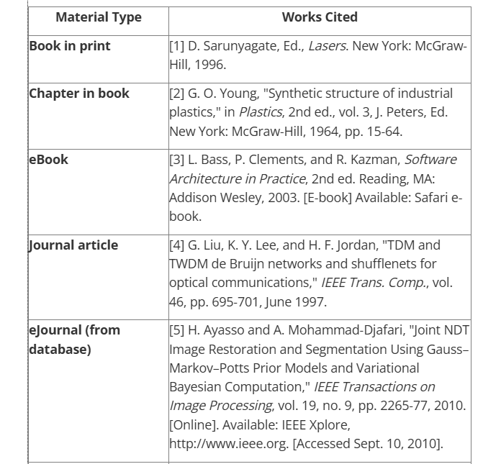

Slide 28
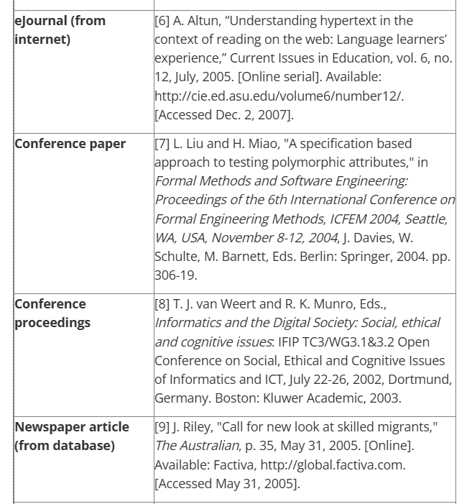

Slide 29
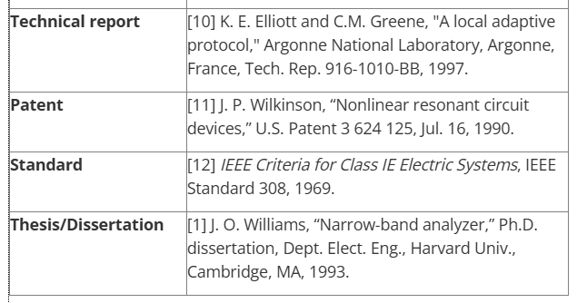

Slide 30
10. Appendices
Supplementary materials, such as raw data, survey questionnaires, or additional analyses, are included here.

